Slide 1
Types of Enclosures

Slide 2
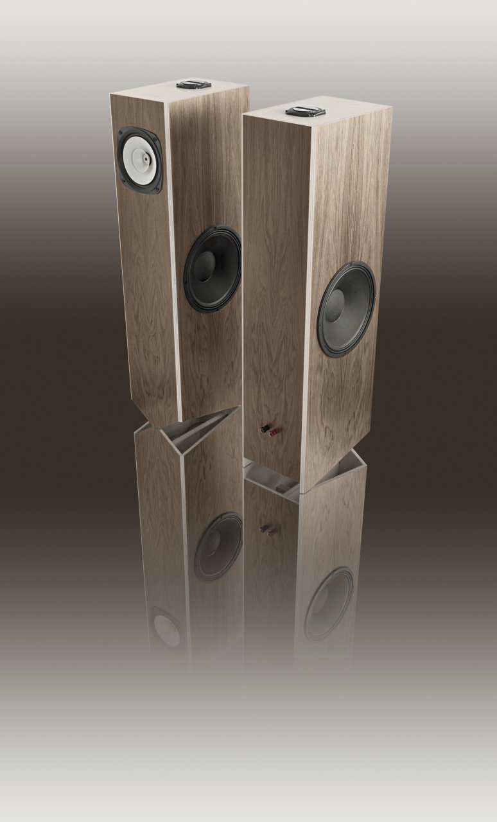
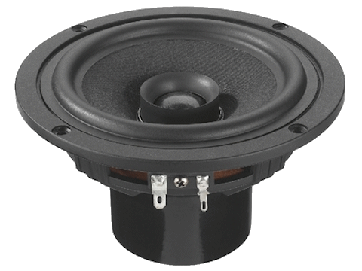
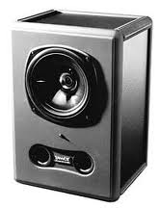
Point Source
Sound comes from a single point on the speaker

Slide 3
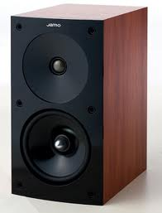
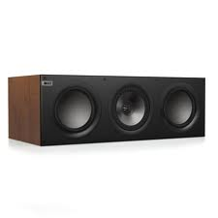
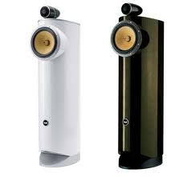
Two Way
Audio is split between a tweeter and mid-bass driver

Slide 4
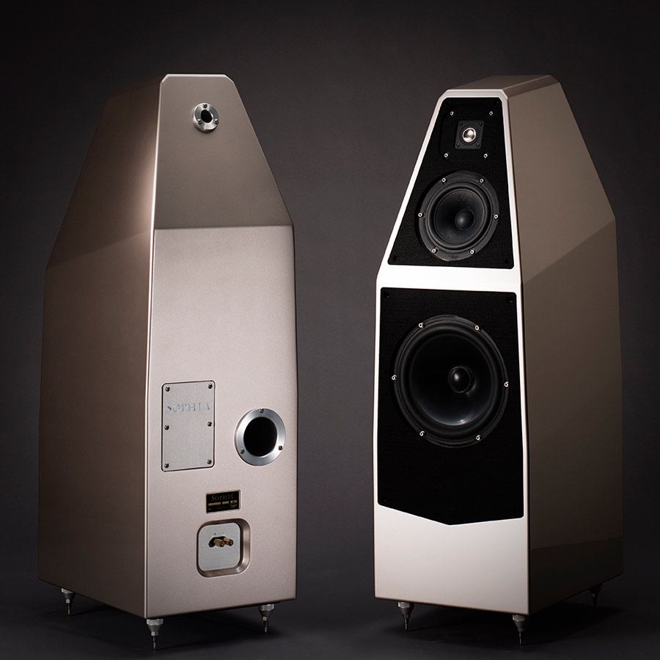
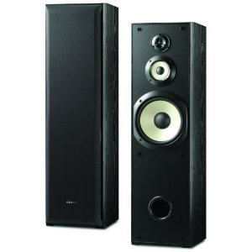
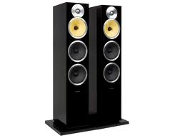
Three way
Audio is split between a tweeter, mid-range, and woofer

Slide 5
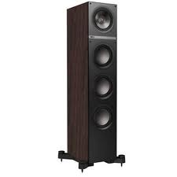
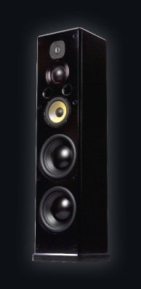
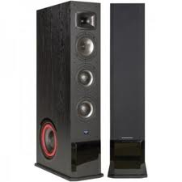
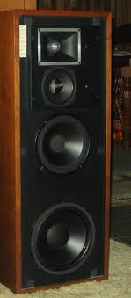
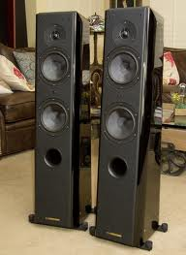
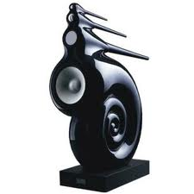
Multi-way

Slide 6
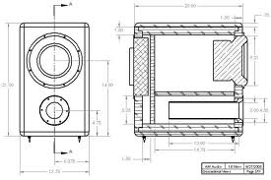
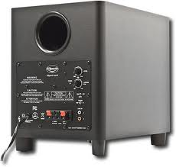
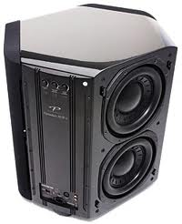
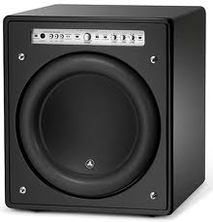
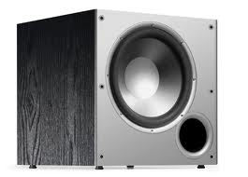
Subwoofer

Slide 7
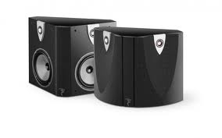
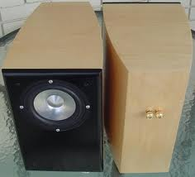
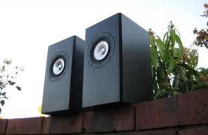
Sealed Enclosure
In a closed-box, the air inside the box acts as a spring, returning the cone to the 'zero' position in the absence of a signal.
A significant increase in the effective volume of a sealed-box loudspeaker can be achieved by a filling of fibrous material, typically fiberglass, bonded acetate fiber (BAF) or long-fiber wool.

Slide 8
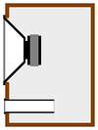
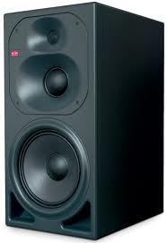
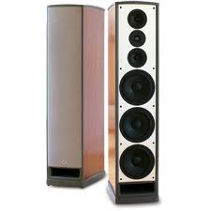
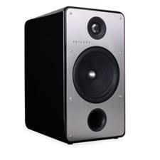
Bass Reflex Enclosure
Also known as vented (or ported) systems, these enclosures improve low-frequency output, increase efficiency, or reduce the size of an enclosure, using cabinet openings or passive radiating elements to transform and transmit low-frequency energy from the rear of the speaker to the listener.
Port tuning frequency is a function of cross-section and length. This enclosure type is very common, and provides the maximum deep-bass output for a given enclosure volume.

Slide 9
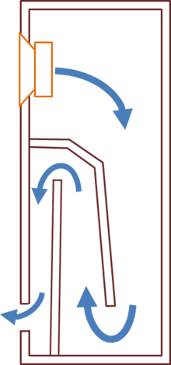
Transmission Lines
Sound from the back of the bass speaker chassis passes along a long (generally convoluted) path within the speaker enclosure.
The energy is absorbed on this path, or emerges from the open end in phase with the sound radiated from the front of the driver, enhancing the output level at low frequencies.
Proper transmission line loudspeakers employ a tube-like resonant cavity whose length is set between 1/6 and 1/2 the wavelength of the fundamental resonant frequency of the loudspeaker driver being used.

Slide 10
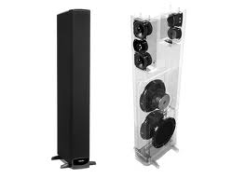
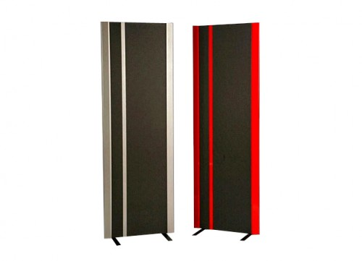
Bipole/Dipole
Bipolar - Sound coming out of the back is in phase
Dipolar - Sound coming out the back is 180 degrees out of phase

Slide 11
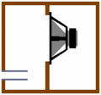
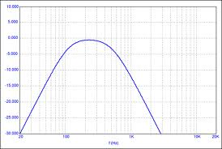
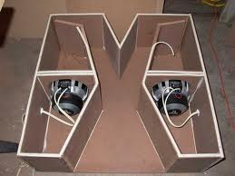
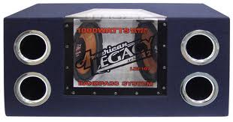
Bandpass Subwoofer
A 4th order electrical bandpass filter can be simulated by a vented box in which the contribution from the rear face of the driver cone is trapped in a sealed box, and the radiation from the front surface of the cone is into a ported chamber.
This modifies the resonance of the driver. In its simplest form a compound enclosure has two chambers.
The dividing wall between the chambers holds the driver; typically only one chamber is ported.

Slide 12
Crossover Networks

Slide 13
Electronic terms
Series – One pathway for the electrons to flow
Parallel – Multiple paths for the electrons to flow
Electrical components
Capacitor
Inductor
Resistor

Slide 14
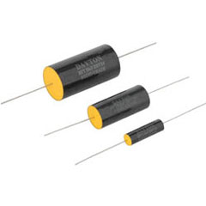
Capacitors
Used to store energy in an electric field
Two conductive materials separated by a Dielectric material
Measured in Farads
Higher resistance for lower notes

Slide 15
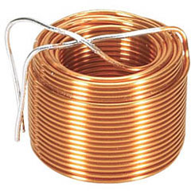
Inductors
Used to store energy in a magnetic field
Inductance is measured in henries
Higher resistance for higher notes

Slide 16
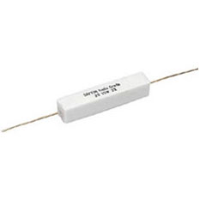
Resistors
Used to lessen voltage
Resistance is measured in ohms

Slide 17
Schematic Symbols
Capacitor
Inductor
Resistor

Slide 18
High Pass Filter

Slide 19
Low Pass

Slide 20
Band-Pass

Slide 21
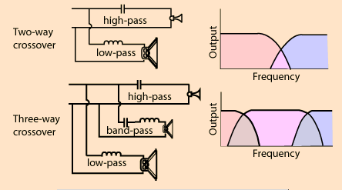
Two-Way and Three-Way

Slide 22
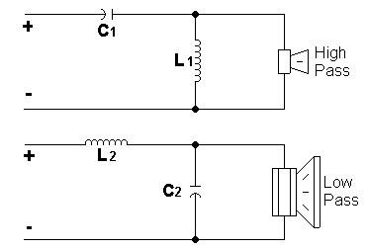
Second Order - 12dB/octave

Slide 23
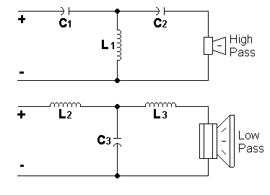
Third Order - 18dB/octave

Slide 24
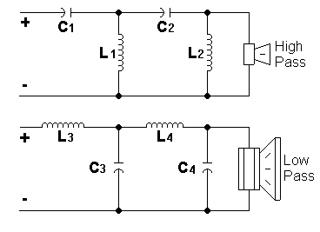
Fourth Order - 24dB/octave

Slide 26
Company Profile
Leader in Industry
Mid 70’s
Oskar Heil – Air-Motion Transformer
ESS Laboratories – Southern California

Slide 27
AMT Limited Edition

Slide 28
The Great Heil Driver
Folded Diaphragm
Acts like a Bellows
Five Times Faster
Inherently Dipole
Wide Horizontal Dispersion

Slide 29
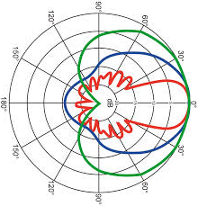
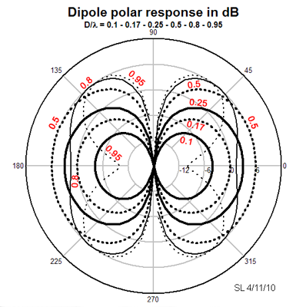
Dipole Radiation
Point Source
Dipole

