Slide 1
Mechanical & Chemical Bonding
James G. Byrne

Slide 2
What is Bonding?
-Join or to be joined securely to something else
Join or to be joined by a chemical bond
Jargon- special words used by particular professional or group and are difficult for others to understand.
Fasten
Affix
Attach
Fuse
Bind

Slide 3
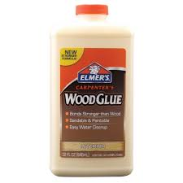
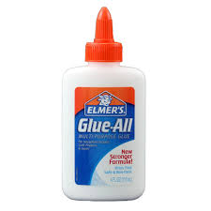
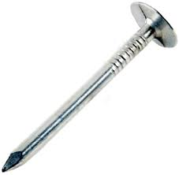
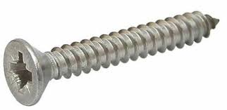
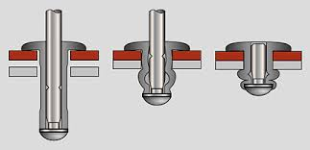
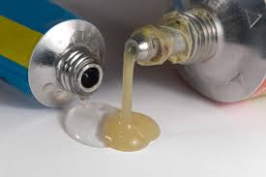
Types:
Mechanical Fasteners
-Nails
-Screws/Bolts/Nuts
-Rivets
Chemical
-Glue
-Adhesive
-Epoxy

Slide 4
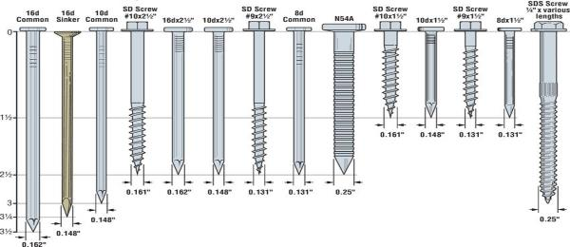
Mechanical Fasteners
Nails
Faster
Cheaper
Non-Reusable
Pull-out but can be knocked back in
Screws
Slow
More expensive
Reusable
Stronger
Rivets
Slower
Expensive
Non-Reusable
Special Tool Required
Tool is bulky to fit in hard to reach locations
If damaged have to be drilled out and replaced. No quick fix

Slide 5
Why Choose a Chemical Bond
Stronger, safer, easier to clean up and less expensive than polyurethane glues.
Allows eight minutes of open time and has an application temperature as low as 47 degrees F.
One hour clamp time!
Cleans up with water.
Does not foam.
Superior waterproof

Slide 6
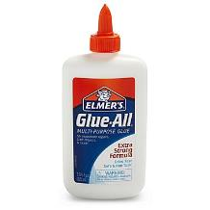
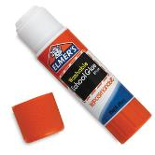
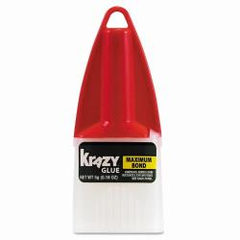
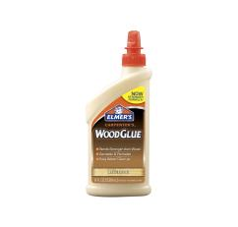
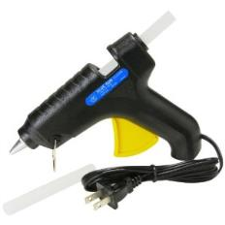
Types of Glue and their uses
Glue Stick-
Elmers Glue-
Wood Glue-
Hot Glue-
Crazy Glue-

Slide 7
Why to use Yellow Glue
Stronger, safer, easier to clean up and less expensive than polyurethane glues.(gorilla glue)
Allows five (5) minutes of open time and has an application temperature as low as 47 degrees F.
Less hours for clamp time!
Cleans up with water.
Does not foam.
Water-resistant when dried

Slide 8
Chemical Bonds
Yellow glue (aliphatic resin or carpenters' glue):
Aliphatic resin glue is a yellow liquid, usually sold in plastic squeeze bottles and often labeled as carpenters' glue.
Yellow glue is very similar to white glue but forms a slightly stronger bond.
It is also slightly more water resistant than white glue.
Clamping is required for about 30 minutes until the glue sets; curing time is 12 to 18 hours.
Yellow glue dries clear but does not accept wood stains.

Slide 9
Gluing Issues
inconsistent glue coverage.
different wood species absorb glue at different rates.
varying absorption rates.
Hardwoods and softwoods will require different amounts of glue

Slide 10
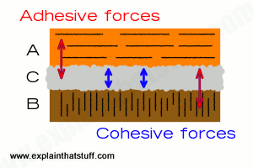
Chemical reaction
Adhesives have to stick to itself but it also have to stick to the matertials
cohesive forces- Sticks to itself. Water droplets on window form bigger droplet
adhesive forces- Adhere to an object. Water droplet sticking to window

Slide 11
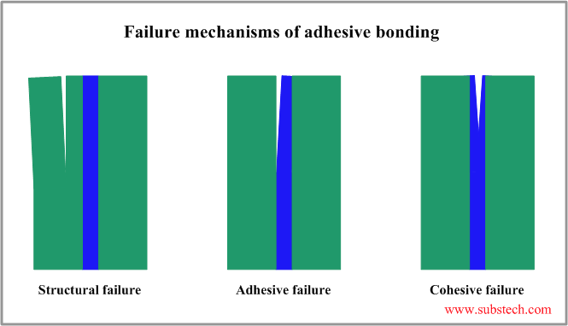
Testing the strength of the Bond

Slide 12
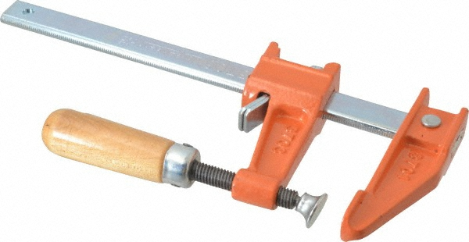
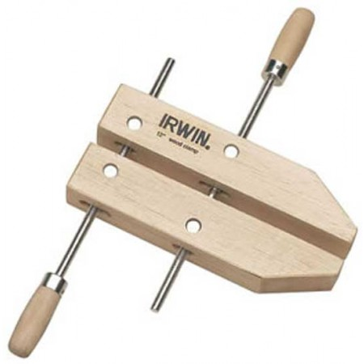
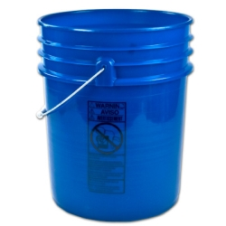
Clamping Techniques
Bar Clamps
Apply pressure to the surfaces with create a tight seal between the two boards being bonded
Wooden screw clamps:
Heavy objects:
5 gallon water buckets
Sand Bags
Textbooks

Slide 13
Wood-Joints

Slide 14
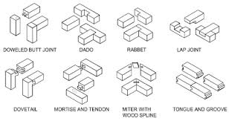

Slide 15
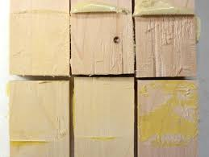
Sample Glue Breaking force
1 Gorilla, gapped 15
2 Gorilla, no gap 230
yellow, gapped 210
4. yellow, no gap 190
5 Gorilla, no gap 205
6 yellow, no gap 180
7 yellow, gapped 200
8 Gorilla, gapped 15
9 Gorilla, no gap 225

