Slide 1
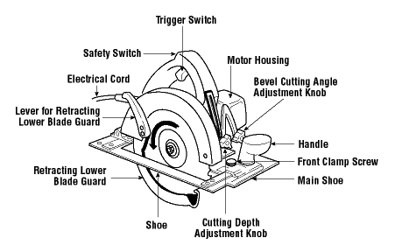
Name:___________________ Carpentry

Slide 2
Circular Saw Pre-Check
Always wear Safety Glasses.
With Saw UNPLUGGED check lower blade guard retracts and springs back smoothly.
Check Saw blade for proper rotation
Set depth of blade 1/8”-1/4” beneath the wood thickness.
Inspect power cord for damage.
Check to make sure you are using the proper Right/Left hand saw

Slide 3
Working Safely with the Circular Saw
Check that the retracting lower blade guard has returned to its starting position before laying down the saw.
Keep upper and retracting lower blade guard clean and free of sawdust.
Disconnect power supply before adjusting or changing the blade.
Allow the saw to reach full power before starting to cut.
Use two hands to operate saws - one on a trigger switch and the other on a front knob handle.
Keep motor free from accumulation of dust and chips.
Select the correct blade for stock being cut and allow it to cut steadily. Do not force it.
Secure stock being cut to avoid movement.

Slide 4
What to Avoid
Do not hold or force the retracting lower guard in the open position.
Do not place hand under the shoe or guard of the saw.
Do not over tighten the blade-locking nut.
Do not twist the saw to change, cut or check alignment.
Do not use a saw that vibrates or appears unsafe in any way.
Do not force the saw during cutting.
Do not cut materials without first checking for obstructions or other objects such as nails and screws.
Do not carry the saw with a finger on the trigger switch.
Do not overreach. Keep proper footing and balance.
Do not rip stock without using a wedge or guide clamped or nailed to the stock.

