Slide 1
Laying out the Foundation
Mr. Byrne
Carpentry

Slide 2
Tools:
String: used to distinguish the dimensions of the building layout.
Hammer: used to sink stakes into the ground.
Chalk line: Used to make straight lines and deposit chalk as a reference.
100ft measuring tape: used to measure diagonals.
Line level: gives best measurement on a taught line and placed n the middle.
8D Nails: attach line to batter boards
Framing Square: used to measure 90 angles

Slide 3
Find the Location
Look at local building codes:
Easements
Property boundaries
Property drainage (garage/Shed)

Slide 4
Determine the Size of the foundation
Width and length
House we are building is 16’ x 24’
Activity is foundation is 6’ x 6’

Slide 5
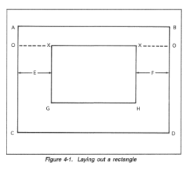
Layout foundation
Using a road or property line as a reference determine the maximum size of the foundation
Sides:
AB is the front
AC is the left side
BD is the right side
CD is the back

Slide 6
Measure Side AB
Place a stake in the first corner and label it “A”
Measure to the adjacent corner and label it “B”
What is the formula for Pythagoreans theorem
A² + B² = C²
3² + 4² = 5²
9 + 16 =25

Slide 7
Side C & D
Find location for stake C & D
At this point you will need two tape measures and a
t-Square
NEVER ADJUST LINE AB. It is your reference line and all other lines are based off of it.
Measure Diagonals

