Slide 1
Hardwood & Softwoods
Mr. Byrne

Slide 2
Turning a tree into Lumber
Manufacturing of Lumber
Select trees to be harvested
Cut down trees
1940’s vast majority of American Forest were depleted
Industrial Revolution
Solution: Tree Farming
Fast growing trees such as Pine were selected
Trees grow without competition for nutrients and sunlight

Slide 3
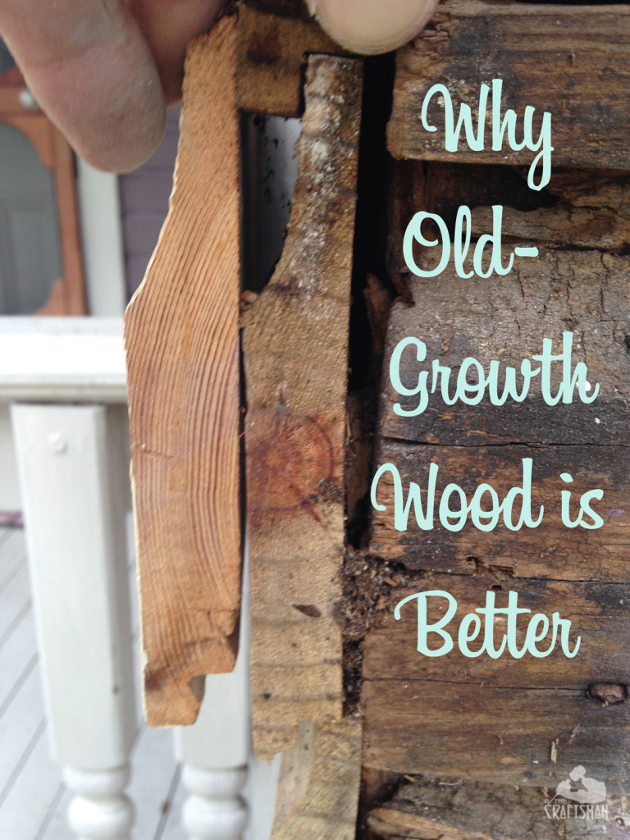
Old Growth vs. New Growth
Old growth lumber
Annual Growth Rings are more compact
Benefits
Stronger
Support large loads
More Stability
Less Expansion & Contraction
More Rot Resistant
Interior heart wood
Termite Resistant not proof
Denser rings are not as east for termites to eat

Slide 4
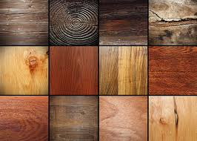

Slide 5
Hardwoods
Deciduous trees: normally lose their leaves
Types: maple, oak, ash, balsa
Have a slower growing rate
Color- Dark
Plants that produce seeds with some sort of covering

Slide 6
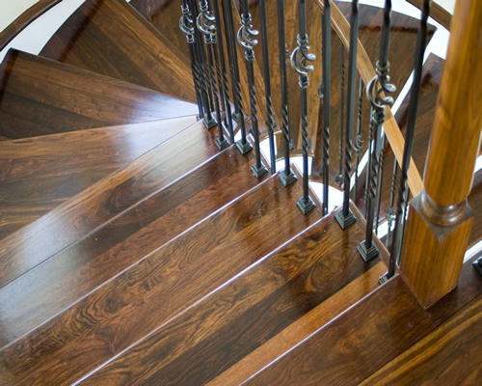
Uses
Construction
Furniture
Flooring
Utensils

Slide 7
Softwoods
Conifers trees: have needles, normally do not lose them
Types: Pine, spruce, cedar
Has a faster rate of growing
Color- Light
Plants having seeds with no covering
Less Dense Growth rings
Less expensive

Slide 8
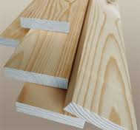
Uses:
Construction
Windows/Doors
Furniture
Medium Density Fiber Board (MDF)

Slide 9
