Slide 1
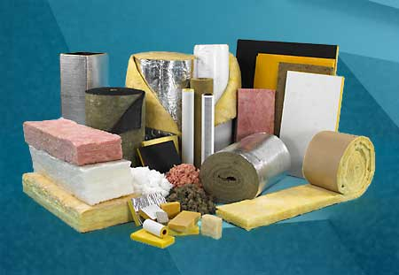
insulation

Slide 2
R-Value
An R-value indicates insulation's resistance to heat flow.
The higher the R-value, the greater the insulating effectiveness

Slide 3
New York state R-values
Ceilings: R-49
Walls: R-21
Floors: R-30
Basement Wall: R-13

Slide 4
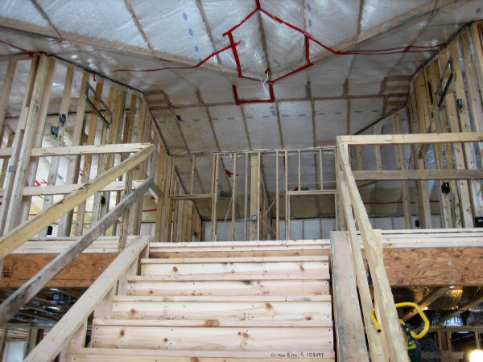
Types of insulation

Slide 5
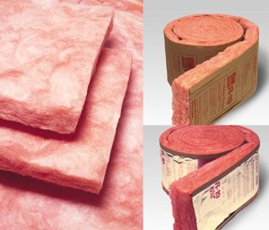
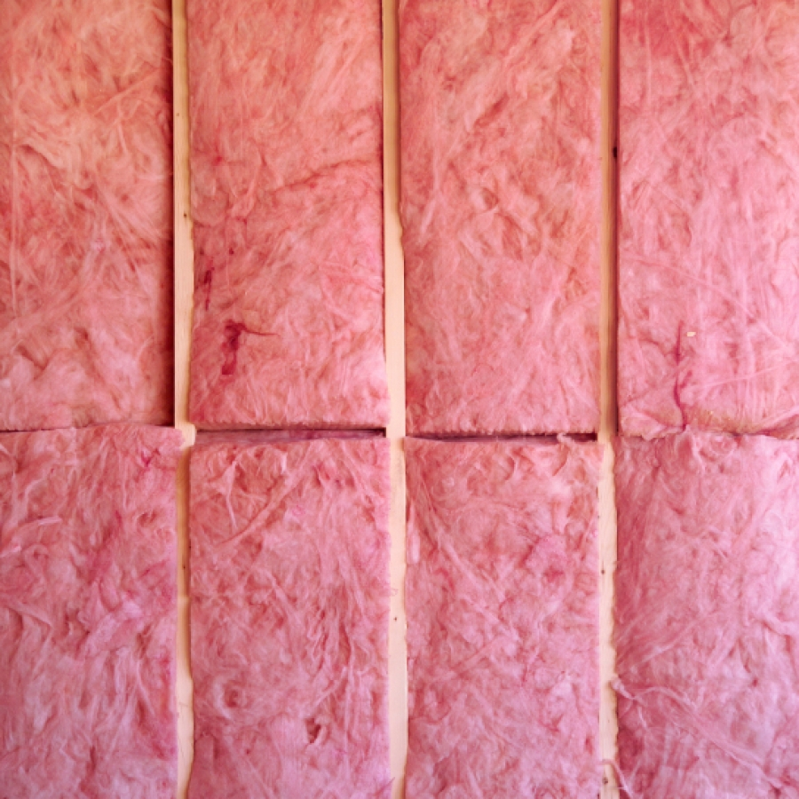
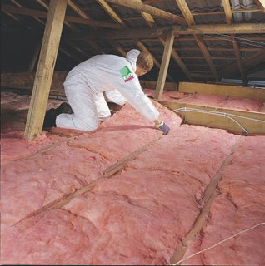
Fiberglass insulation
R-value 3.2 per inch

Slide 6
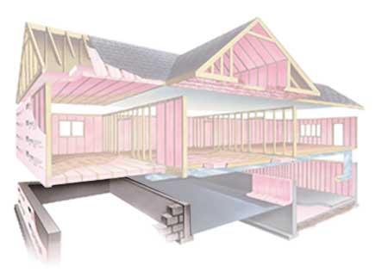
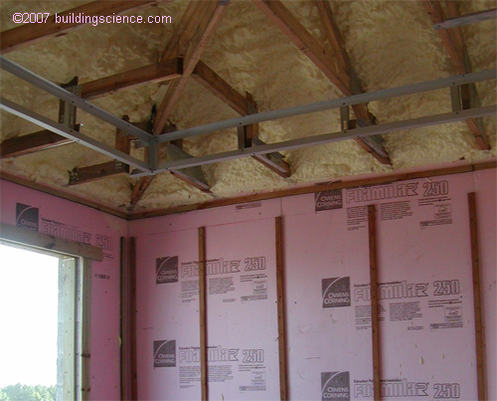
Rigid foam insulation
R-value 4.0 to 6.5 per inch

Slide 7
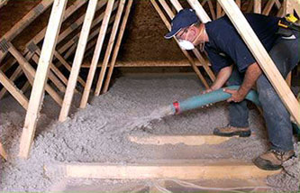
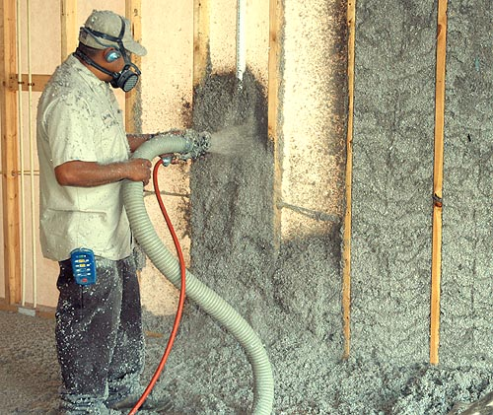
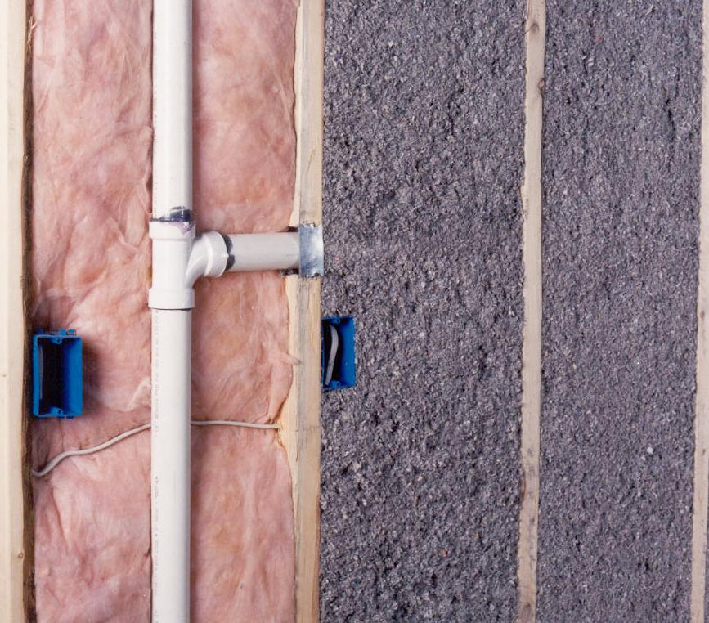
Cellulose thermal insulation
R-value 3.2 per inch

Slide 8
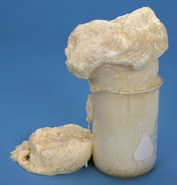
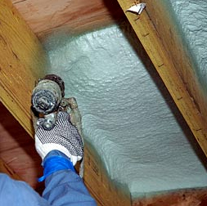
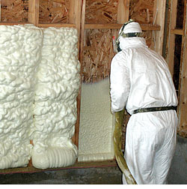
Urethane foams
R-value 4.5 to 6.5 per inch

Slide 9
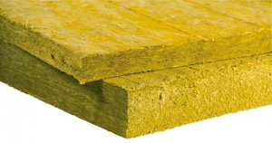
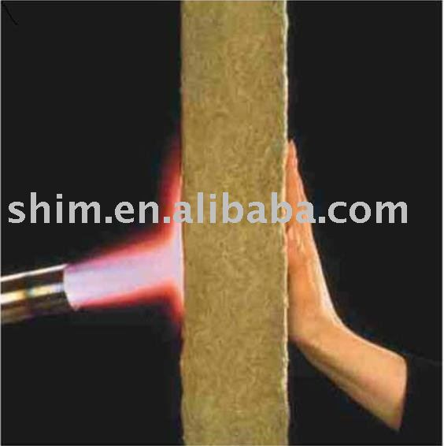
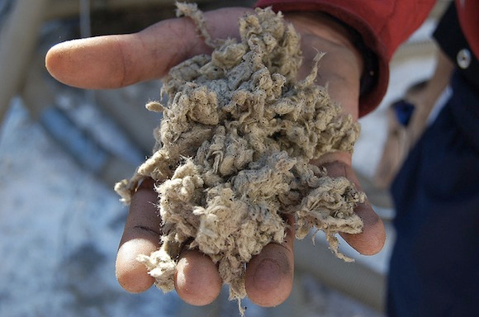
Mineral-fiber insulation
R-value 3.1 per inch

Slide 10
