Slide 1
Footing and Foundation Plan:
Using Scale Ruler:
Construction Vocabulary:
Project Description:
Work on Project:

Slide 2
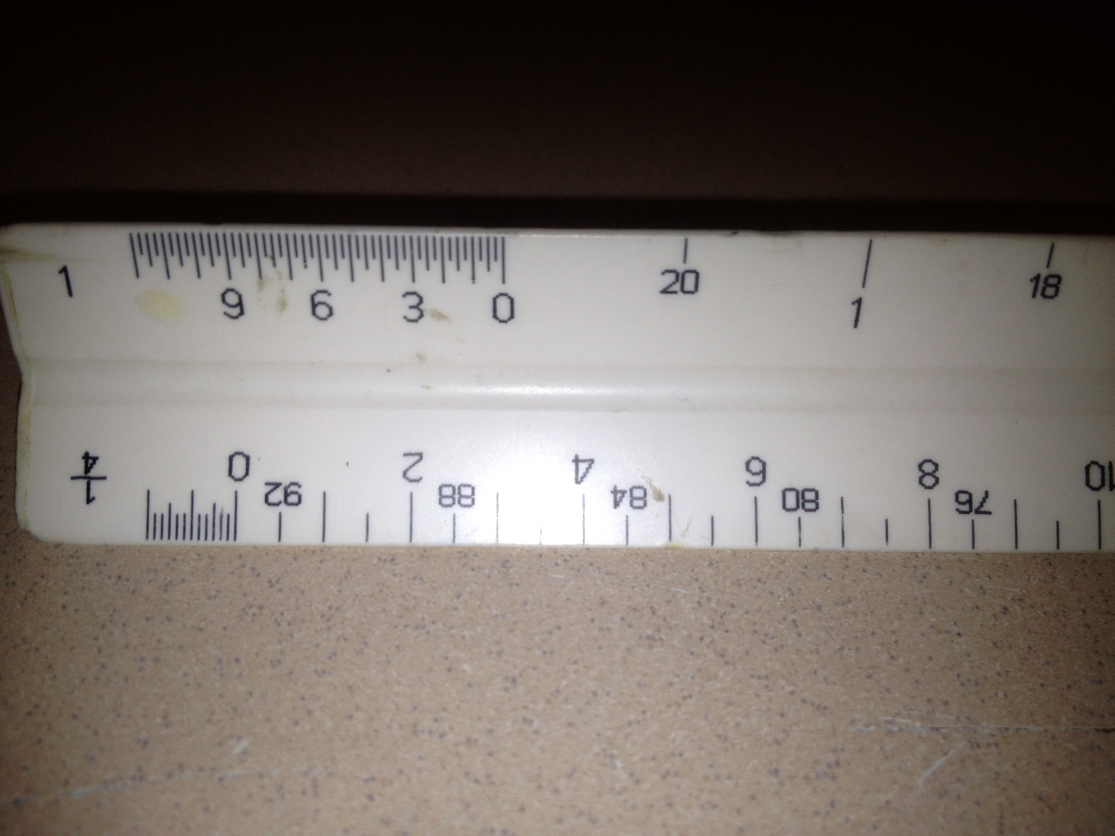
Scale Ruler:
1 inch = 1 foot
4 Inches

Slide 3
0-7
0-7

Slide 4
Pythagorean Theorem
A^2+ B^2= C^2
3,4,5 Triangle
Do At Least 3 Corners!!!!!
DO NOT WANT TRAPAZOID or PARALLELOGRAM
10
6
8

Slide 5
Measure Diagonally Corner t to corner. If SQUARE measurement will be the SAME

Slide 6
0-7
0-16
0-7
0-16

Slide 8
Footing Plan
Place Wooden Footing On Outside Line

Slide 9
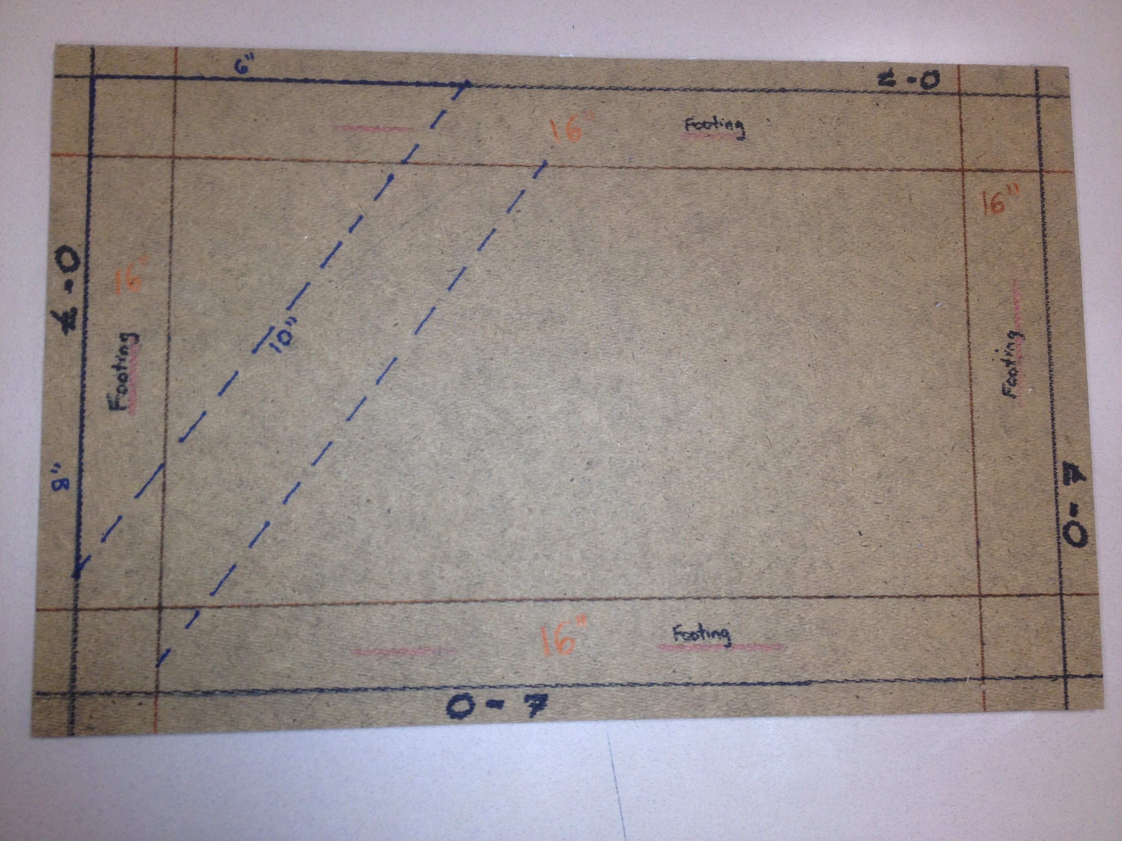
Final Footing Plan:

