Slide 1
Common Mistakes in Photography

Slide 2
“Distractions on the Edge”

Slide 3
“Merging Subject and Background”

Slide 4
“Kissing the Edge”

Slide 5
Take SHARP pictures …
Focus on details
Focus on EYES
Up the ISO(international standards organization)
exposure, aperture, shutter speed
Speed up the shutter
NOT Sharp

Slide 6
“Skewed Lines”
Keep verticals vertical and horizontals horizontal!

Slide 7
“If your photos aren’t good enough, you’re not close enough.”
Ordinary objects become extraordinary!

Slide 8
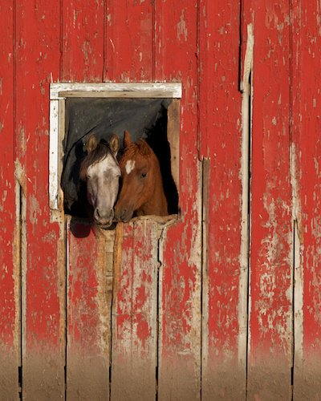
Make sure your photos have a subject:
What is this is picture of
and why was it taken?

Slide 9
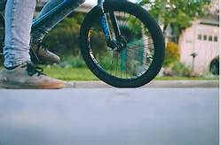
Focus on the subject:
Takes ordinary and again, turns into
EXTRAORDINARY!

Slide 10
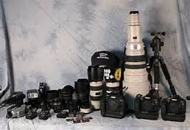
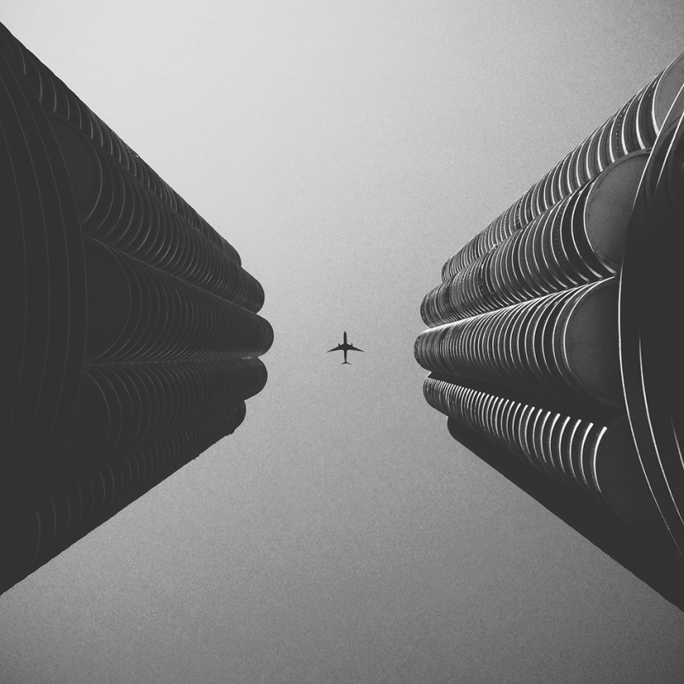
Thinking more expensive equipment will provide better photos …
Taken with iPhones

Slide 11
Biggest mistakes:
NOT… taking a photo, taking 10 more as a backup, rotating the camera,
taking 10 more, showing them to someone, asking for an
honest opinion, discussing photos, editing photos, arguing
about how to make them better, and continuing
to get better …

Slide 12
How to resolve these common mistakes:
Change the angle you are taking the picture.
Change the distance you are taking the photo
Modify the scene. Move objects if possible if they are in your photo
Photo Editing software-Crop photo, etc

