Slide 1
Rules of Thirds
Mr. Byrne

Slide 2
Purpose:
Creates a balanced and interesting photo
Identifies (4) important parts of the image, where you should position points of interest while framing your image
Studies show that the human eye is attracted to these locations rather than the center of the photo

Slide 3
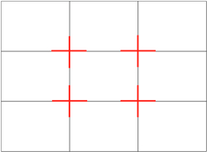
How:
Slice your image into thirds both vertically and horizontally creating a grid of 9 squares
Points of interest should be located where the lines intersect
Landscape Photos- Place the horizon along one of the horizontal lines

Slide 5
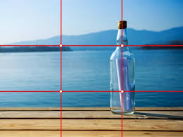
Examples:

Slide 6
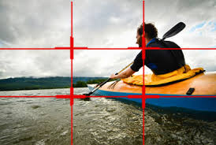
example

Slide 7
example

Slide 13
