Slide 1
Interior Wall Coverings
Created By:
Mr. Byrne

Slide 2
Common Sheetrock Sizes:
Thickness of Boards:
1/4 ”
3/8 ”
1/2 ”
5/8 ”
Dimensions of Boards
4’ x 8’
4’ x 12’
2’ x 2’ for patch work
Half Boards are available

Slide 3
Types Of Interior Coverings
Paneling: constructed from 1/8”-1/4” wood.
Cork, bamboo,
Sheetrock: panel made of gypsum plaster pressed between two thick sheets of paper.
1/4”, 3/8”, ½”, 5/8” are available sizes.
½” and 5/8” boards are manufactured to be fire resistant
Attached garage must have fire resistant rating (TYPE X)
5/8” boards provide better sound insulation
*Gypsum Plaster is POROUS. Mold and mildew will grow rapidly
Green Board: drywall that contains an oil-based additive in the green colored paper covering that provides moisture resistance. It is commonly used in washrooms and other areas expected to experience elevated levels of humidity.
Wonder Board: Wonderboard is a cement-based backer board used for wet places. The wet places are mostly bathrooms, and the applications tend to be tiling. Exclusively? No. It can also be used for decks, floors, and countertops. But most people think of it as a backer board for tiling in wet places like showers and bathtubs. Crumbles easily

Slide 4
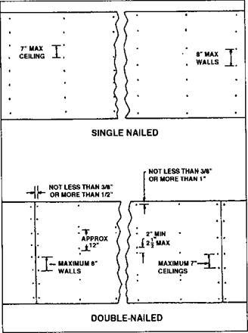
Nailing/Screw pattern
Single Nailed:
Ceiling: 7” maximum spacing
Walls: 8” maximum spacing
Doubled Nailed:
Ceiling: 7” spacing around perimeter while center is nailed every 12” with a DOUBLE NAIL 2” away
Wall: 8” spacing around perimeter and the center is the same as the ceiling
Always Work from seamed edge outward. Do NOT do perimeter then middle will create UNFIXABLE warp WHY USE SCREWS INSTEAD OF NAILS?????????

Slide 5
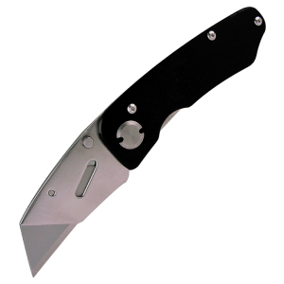
SheetRock:
How to cut SheetRock
Razor Knife- score white side of board fold over and cut paper backing. Smooth edge formed when using drywall square
Sheetrock saw- Saw with a pointed tip to pierce through sheetrock and then cut like a regular hand saw. Creates rough edges and tears paper to shreds.

Slide 6
How to orientate Board to the wall
Long side perpendicular to studs (90 degrees)
Most common because it ties more studs together and creates less seams
Long side parallel to wall studs
used when ceiling height is higher then 8 feet
Tapered Edge versus Cut Edge
Always match tapered edges together
WHY?????????

Slide 7
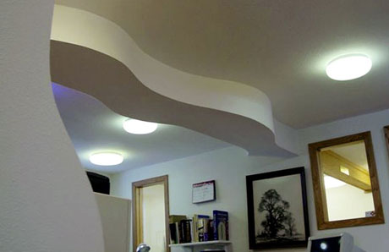
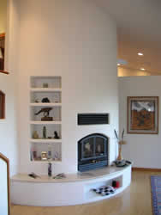
How to Curve SheetRock
1/4” sheetrock:
- best suited for task
-Can be done dry and double layered to form ½” material.
-Overlapping seam MUST be 10” apart
3/8” sheetrock:
-can be wetted to soften the gypsum plaster
-Inside curve score backside paper
-Outside curve score front side of board and then tape and spackle
THIS IS AN ART FORM that takes a lot of practice to master

