Slide 1
Tool Safety Rules:
Mandatory

Slide 2
BandSaw Safety:
1- Always ASK Permission
2- WEAR SAFETY GOOGLES
3- Tell ME what you are cutting
4- Check doors(closed and locked)
5- Adjust upper Guard Assembly 1/8’ above project
6- Keep Fingers away from cutting blade
7- If you hear clicking as you cut ( IF YES SHUT OFF MACHINE)
8- Make sure GUARDS are locked
9- Do not cut sharp curves
10- Make relief cuts when necessary
11- Always leave line on wood
12- Never use hands to remove scrap
13- Do Not wood too fast
14- Do NOT back out of cuts
15- Always Shut OFF and Apply brake

Slide 3
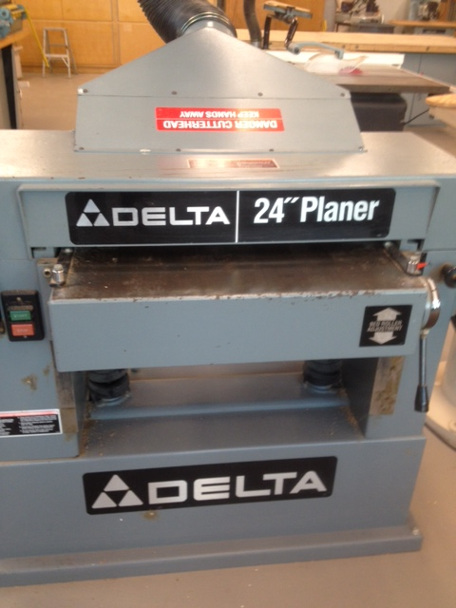
Surface Planner
1- ALWAYS ASK PERMISSION
2- WEAR SAFETY GOOGLES
3- Tell ME what you are cutting
4- Check wood for defects (Knots)
5- Never Surface Paint, Varnish or Glue
6- Board should have one true side
7- Stand to side, NEVER DIRECTLY BEHIND
8-NEVER plane board under 10 inches
9-Always plane with GRAIN
10-Let go of wood as soon as machine grabs
11-Never LOOK into planner
12-If board gets stuck turn machine OFF, lower bed
13-Do not wear loose clothing
14-Guide long pieces out
15- Start wood straight, NOT on angle
16- Remove MAXIMUM of 1 turn on wheel each pass

Slide 4
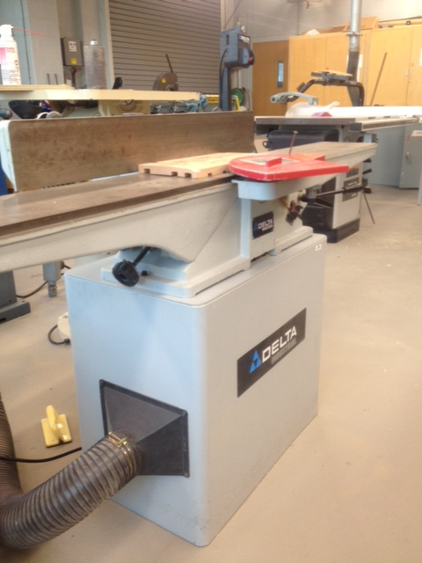
Jointer:
1-Ask Permission
2-Wear safety Glasses
3-Tell ME what YOU are Cutting
4-Always keep the guard in place
5-Lock all parts of the machine
6- Use push stick for pieces 4 inches or less
7- Never joint wood under 11 inches
8- Keep fingers above your piece of wood
9- Stand to the left of the machine
10-Check table for Square
11- Hold board tight against fence
12-Check wood for knots and other defects
13-When face jointing use push stick
14- NEVER JOINT END GRAIN

Slide 5
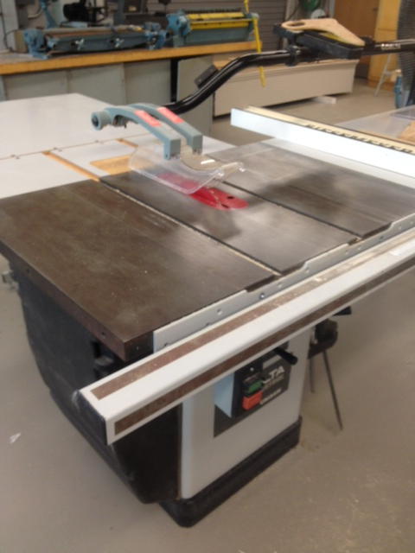
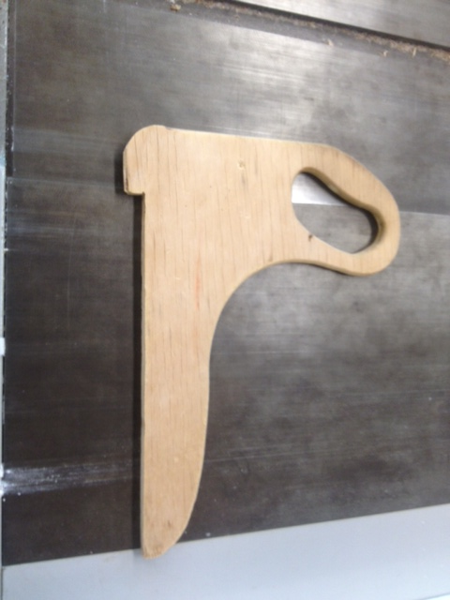
Tablesaw:
1- ASK permission to use machine
2- Wear Safety Glasses
3- Tell me what you are cutting
4- Adjust blade ¼’ above the wood
5-Blade Guard Down
6-Use push stick for pieces under 4 inches
7- Stand to the Left or Right of the blade
8-Make Adjustments with POWER OFF
9- Do not remove wood scraps with hands
10-Adjust cutting angle to 90 degrees (Use square to check
11- Never use Miter gauge while Ripping
12 Never use Ripping fence while Crosscutting
13- When Ripping ALWAYS use Rip Fence
14-Never cut FREEHAND

Slide 6
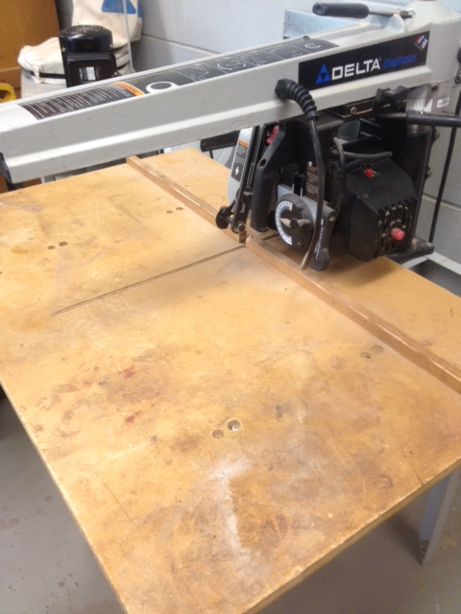
Radial Arm SAw
1- Always ask permission
2- WEAR SAFETY GLASSES
3- Cross Cuts Only
3- Tell ME what YOU are cutting
4- Make sure saw is cutting at 90 Degrees
5- CLEAN OFF TABLE ( SAW DUST)
6- Stand to the left side of the saw
7- Grab SAW handle with right hand
8- Hold wood down with left hand up against fence
9- Keep hands minimum of 6 INCHES from cutting blade( Keep hands out of redzone)
10- Keep A good Base
11- Adjust the anti-kick back
12- Adjust the saw blade ¼” below wood
13- Cut through wood and return blade to rear of table
14- Shut saw OFF
15- DO NOT REMOVE SCRAP WITH HANDS

Slide 7
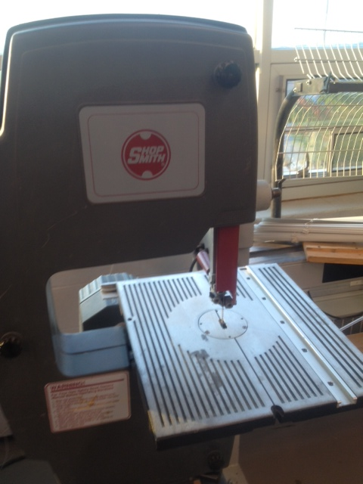
Bandsaw:
1-Always ask permission
2-WEAR SAFETY GLASSES
3- Tell ME what YOU are cutting
4- Check Doors (closed and locked)
5- Adjust upper Guard Assemble 1/8” above wood
6- Keep Fingers away from blade
7- If you hear clicking as you cut Shut it Off
8-Make sure GUARDS are locked
9-Do NOT cut sharp curves
10-Make relief cuts when necessary
11- Always Leave line on wood
12- Never use hands to remove Scrap
13- Do NOT push too fast
14- Do NOT back out of cuts
15- Always SHUT OFF and APPLY BRAKE

