Slide 1
Do Now #7
What are the dimensions of the footing?
When installing the sub floor it is important to_____________ the seams
.
Name two types of floor joist bracing and why it is important.
What are the two measurements used when laying out floor joists?
5. List two reasons a subfloor is needed.

Slide 2
WALL SYSTEMS
By:
Mr. Byrne

Slide 3
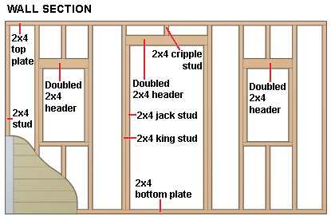
Wall Systems:
Wall Framing- Includes assembling the vertical and horizontal members that form the inside and outside walls
Supports upper floors, ceilings, and roofs
Nailing base for wall covering materials
Types of Walls-
Load Bearing- Carries the load from above
Roofs, second story floor
Partitions-Inside walls which separate rooms and do not carry any load

Slide 4
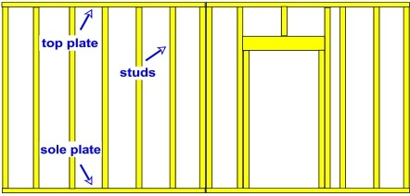
Parts of the Wall Frame
Sole Plate- bottom plate that attaches to the sub floor
Top Plate-Ties all parts of the wall together. Usually doubled up after construction
Studs- 2 x 4 or 2 x 6 lumber that make up the vertical members of the wall. Connects Sole plate to the top plate

Slide 5
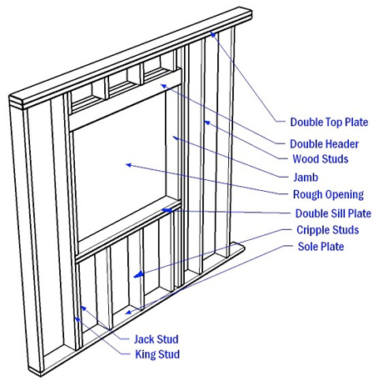
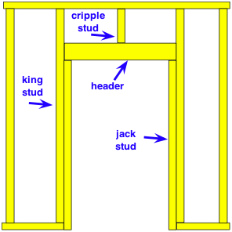
Header- Material over the top of a window or door opening. Minimum 2-2x6 with a ½ plywood spacer
Cripple Stud- Stud that is shortened due to an opening, Transfers the load from the top plate over a door/window opening to the header
Trimmer Stud(Jack Stud)- Supports the load carried by the header
King Stud- Nailed to trimmer stud for added support

Slide 6
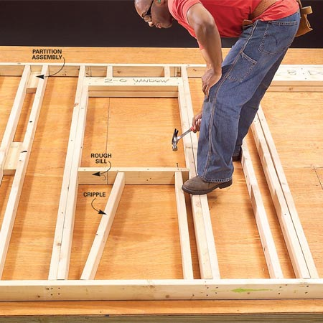
Rough Sill- Frames the lower part of a window opening. Non load bearing
Window Jacks (cripple) Transfers the weight from the rough sill to the bottom plate

Slide 7
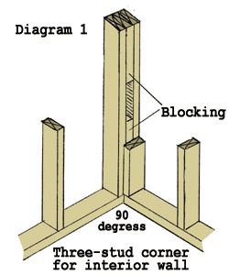
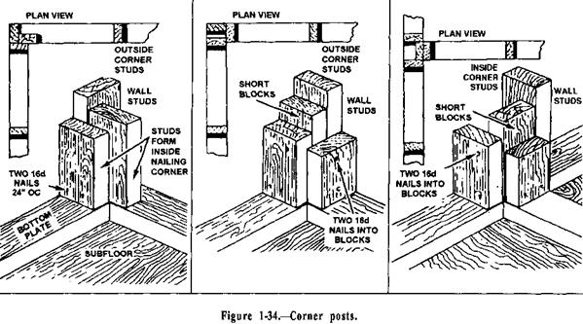
Corners:
Are formed when two perpendicular wall systems are raised.
Methods:
Blocking
Corner Studs

Slide 8
Sheathing:
Exterior material that covers the house and provides structural support.
Standard size is ½”x4,x8’ (Thickness can be up to 5/8”)
Plywood
OSB (oriented strand board)******
Short side (4’) runs parallel to the vertical studs. (HORIZONTAL)

Slide 9
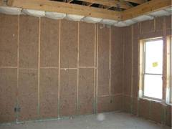
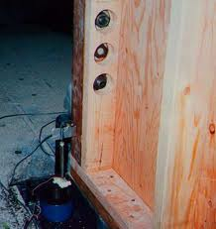
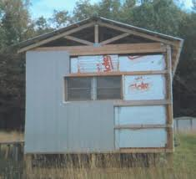
OSB: Green, uses more of the tree. Less waste product
Renewable: Tree type is fast growing
Slow growing trees are stronger then fast grown trees
Plywood: uses in high wind or seismic locations.

Slide 10
Calculating Area:
PLYWOOD/OSB
AREA= L X W
A=4 X 8
A=32 SQ FT
Length x Width
8’
WALL FRAME
AREA = L X W
A= 16’ X 8’
A= 128 SQ FT
4’
128 SQ FT/ 32 SQ FT
4 BOARDS NEEDED

Slide 11
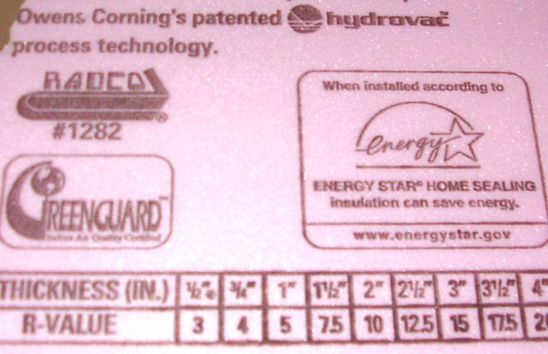
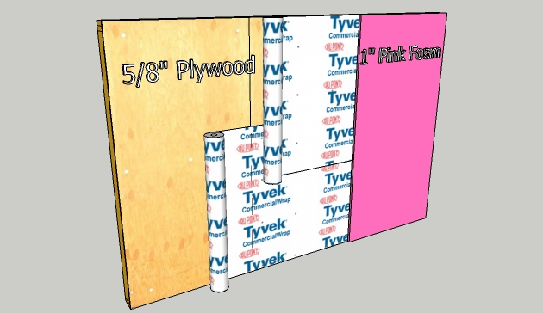
Water Proofing and Insulation:
House Wrap- provides a waterproof barrier between the house and exterior. Has a R value (WATER RESISTANT)
Insulation- 1/4”- 1” ridged foam
Works both ways keeps are in and out
Rated By R value. Higher R value better insulation property
More Insulation on the exterior means drier warmer sheathing. More insulation on interior means colder moist sheathing

Slide 12
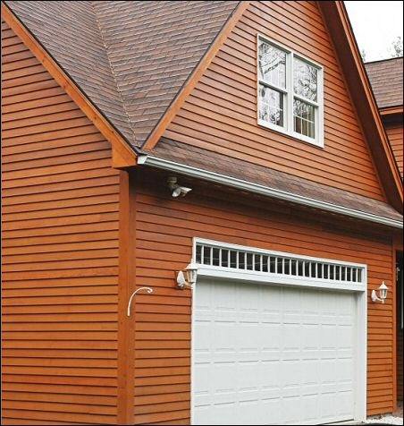
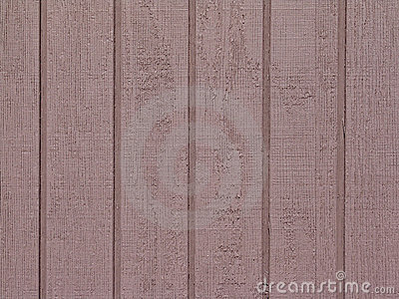
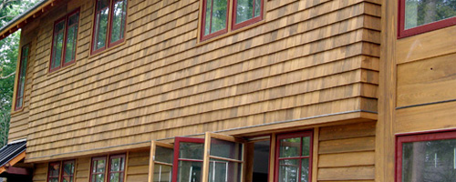
Siding:
Wood-
Clap board
Texture 111 (T111)
Perfection Cedar shakes

Slide 13
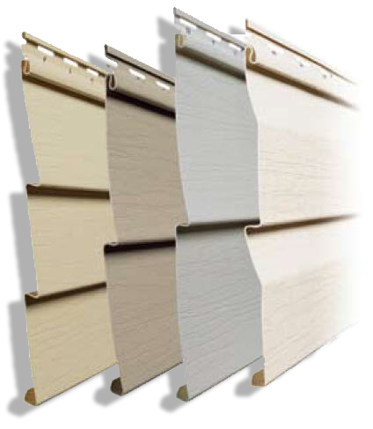
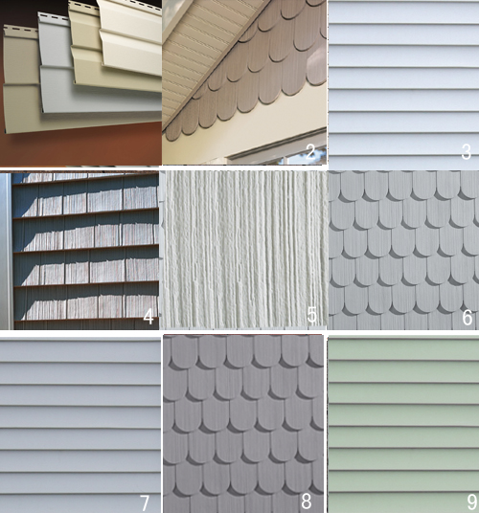
Siding

Slide 14
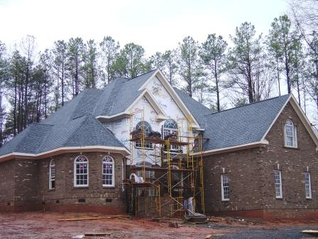
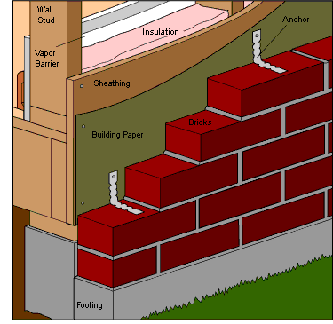
Brick

